Slide 1

Job-Driven Technical Assistance Center (JD-VRTAC): Key First Steps for Connecting with Registered Apprenticeship Programs

Slide 2
JD-VRTAC Goals
Improve skills of state VR agency staff, other rehab professionals & providers of VR services, who are trained to provide “job-driven” VR services & supports to PWD, employers & customized training providers.
Four Topic Areas:
Business Engagement
Employer Supports
Labor Market Information (LMI)
Customized Training Providers
www.explorevr.org

Slide 3
JD-VRTAC Partners
Institute for Community Inclusion (ICI), Univ. of Massachusetts/Boston
In Partnership with:
Jobs for the Future (JFF)
Univ. of Arkansas/CURRENTS
Univ. of Washington
Council of State Administrators of Vocational Rehabilitation (CSAVR)
United States Business Leadership Network (USBLN)
Association of University Centers on Disabilities (AUCD)
In Collaboration with:
National Council of State Agencies for the Blind (NCSAB)
Technical Assistance Center Collaborative

Slide 4
Focus of the Webinar
Outline Strategies for Finding and Connecting with Registered Apprenticeship Programs
Identify the Role that State VR Agencies Can Play in Registered Apprenticeship Programs
Describe How a Relationship with Registered Apprenticeship Programs Can Be Formalized

Slide 5
Agenda
Overview of Key Steps for Finding and Connecting with Registered Apprenticeship Programs
A Model for Collaborating on Apprenticeship: Pennsylvania
Questions

Slide 6
Presenters
Geri Scott, Director, Jobs for the Future
Ralph Roach, Division Chief, Office of Vocational Rehabilitation, Pennsylvania Department of Labor and Industry
Eric Ramsay, Director, Apprenticeship and Training Office, Pennsylvania Department of Labor and Industry

Slide 7
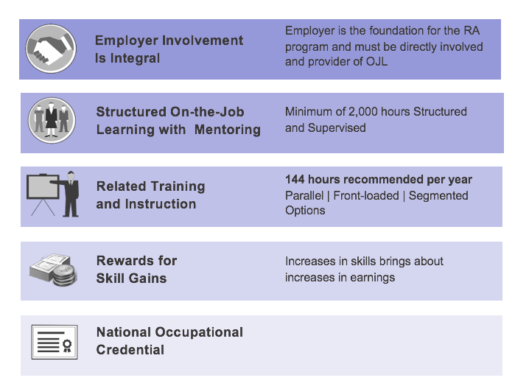
5 CORE COMPONENTS OF REGISTERED APPRENTICESHIP

Slide 8

EQUAL EMPLOYMENT OPPORTUNITY IN REGISTERED APPRENTICESHIP 29CFR Part 29.30
PROMOTE EQUAL OPPORTUNITY for apprentices and applicants for apprenticeship.
DISCRIMINATION PROHIBITED based on race, color, religion, national origin, sex, sexual orientation, age (40 or older), genetic information, and disability.
AFFIRMATIVE ACTION efforts must be taken to ensure equal opportunity for apprentices and applicants for apprenticeship
RELATIONSHIP TO OTHER LAWS. Doesn’t invalidate state or federal law that provides greater or equal protection for individuals based on race, color religion, national origin, sex, sexual orientation, age (40 or older), genetic information or disability.

Slide 9
INVITATION TO SELF-IDENTIFY AS AN INDIVIDUAL WITH A DISABILITY 29CFR 30.11
Pre-offer: A sponsor must invite applicants for apprenticeship to inform the sponsor whether the applicant believes that he or she is an individual with a disability.
Apprentices
The sponsor must make a one-time invitation to each current apprentice to inform the sponsor whether he or she is an individual with a disability;
Thereafter, the sponsor must remind apprentices yearly that they may voluntarily update their disability status.
Voluntary self-identification for apprentices
Confidentiality
Compliance dates: A sponsor must begin inviting applicants and apprentices to identify as individuals with disabilities, pursuant to this section, no later than 2 years after January 18, 2017.

Slide 10
REGISTERED APPRENTICESHIPS SPONSORS
Every Registered Apprenticeship program has a sponsor.
The sponsor is responsible for the overall operation of the program, working in collaboration with program partners.
Signs agreement with state/federal apprenticeship agency and apprentice
Coordinates delivery of RTI and OJT
Documents progress
Assures program quality
Types of Sponsors:
Single business or a consortium of businesses
Industry association
Labor Union
Workforce Board
Community college
Community-based organization
Federal Sponsor Database

Slide 11
Referring Applicants to a Registered Apprenticeship Program
Review list of Apprentice-able Occupations at:
https://www.doleta.gov/OA/occupations.cfm
Link to all job titles that have registered apprenticeships with OA
Explore existing sponsors at
Federal Sponsor Database: https://oa.doleta.gov/bat.cfm
Develop pre-apprenticeship training

Slide 12
Developing a new Registered Apprenticeship Program
Identify employer ready to hire for specific occupation
Explore existing sponsors to see if one is interested in hiring and training
Reach out to Industry Partner contractors or state /federal Apprenticeship Training Representative for help
Develop apprenticeship standards:
Map occupational skills and competencies
Identify Apprenticeship Training Committee
Define qualifications and selection procedures for apprenticeship
Select time-based, competency, or hybrid
Develop on-the-job learning curriculum (2000 hours/year)
Develop Related Technical Instruction (RTI) curriculum (144 hours/year)
Select/train On-the-job learning mentors
Select RTI providers
Negotiate wage progression with employer
Submit sponsorship agreement to state or federal apprenticeship agency for approval
Quick Start Tool Kit https://doleta.gov/oa/employers/apprenticeship_toolkit.pdf

Slide 13
Federal & State Roles OA & SAAs
U.S. Department of Labor, Office of Apprenticeship (OA) and State Apprenticeship Agency States (SAAs).
Directory of State Apprenticeship Offices: https://doleta.gov/oa/contactlist.cfm
DOL = 25 (FEDERAL)
SAA = 26 (STATE)

Slide 14

FOR MOREINFORMATION

Slide 15
State VR Connections with Apprenticeship Programs
PA OVR Apprenticeship Joint Collaboration with State Labor & Industry Office of Registered Apprenticeships (RA)

Slide 16
State VR Connections with Apprenticeship Programs II
1st step - Initial meeting between VR Business Services Staff the PA Labor & Industry Office of Registered Apprenticeships Director.
2nd step -Identify key high priority occupations that use pre-apprenticeship and registered apprenticeships pathways that align with VR customer career goals and training.
Notes:
Our first meeting with Eric Ramsey, PA Dept. of L&I Apprenticeship Office occurred in the Spring of 2016.
OVR Executive Team were present with Business Outreach Division Staff
Eric updated everyone on the new roles and goals of his office.
Eric reviewed the recent announcement of the construction of a Western PA Shell Energy Co. Marcellus's shale cracker plan and need for 500 skilled tradesmen in welding, construction, pipefitting, electricians, etc.
One deliverable from the meeting was:
* OVR development with the BSOD committee of a wage reimbursement OJT
for RA sponsors
* Agreement to tour State owned Commonwealth Technical Institute (CTI) to
tour pre-apprenticeship building /construction certificate program and help
to build a welding program.

Slide 17
State VR Connections with Apprenticeship Programs III
PA occupations with rapid growth and high human capital demands include:
Construction Trades: related to energy industry, highway, commercial and residential construction. High demands for welders, electricians, carpenters, equipment operators and general laborers.
Health Occupations: including nursing, allied health, medical and dental assistants, and medical coding.
Service Sector: including logistics, retailing, office support and food services.
Notes:
OVR OJT experiences in occupations that could lead to Apprenticeships (Super Sectors)
Goods-Producing Industries
Natural Resources and Mining
Agriculture, Forestry, Fishing and Hunting
Crop Production
Animal Production
Support Activities for Agriculture and Forestry
Construction
Construction
Construction of Buildings-includes renovation companies
Heavy and Civil Engineering Construction-Includes land restoration
Manufacturing
Manufacturing
Wood Product Manufacturing- includes cabinet making companies
Printing and Related Support Activities-
Plastics and Rubber Products Manufacturing
Primary Metal Manufacturing-welding
Fabricated Metal Product Manufacturing-includes intricate designs
Computer and Electronic Product Manufacturing
Electrical Equipment, Appliance, and Component Manufacturing
Furniture and Related Product Manufacturing
Service-Providing Industries
Trade, Transportation, and Utilities
Transportation and Warehousing
Truck Transportation
Utilities
Information
Information
Data Processing, Hosting, and Related Services
Financial Activities
Professional and Business Services
Education and Health Services
Health Care and Social Assistance
Hospitals
Nursing and Residential Care Facilities
Leisure and Hospitality
Other Services (except Public Administration)
Repair and Maintenance

Slide 18
State VR Connections with Apprenticeship Programs IV
3rd Step - Develop a Plan of action:
Identify potential pre-apprenticeship pathways available for VR customers in secondary education
Educate VR Counselors, customers and significant others on the benefits of apprenticeship pathways into a career or occupation
Outreach to registered apprenticeship sponsors to explore and understand requirements for acceptance into their program
Develop a model to actively support apprenticeship sponsors on apprenticeship wage and training costs for VR candidates
Notes:
With input from Eric Ramsey a final OTJ model to provide a wage reimbursement and mid-point milestone payment to a RA sponsor was drafted.
Eric assisted a statewide training and roll out of the model. In Dec. 2016

Slide 19
State VR Connections with Apprenticeship Programs V
4th Step - Formalizing a collaborative for VR/RA relationship:
Engage specific apprenticeship sponsors to create RA’s accessible to VR talent
Build apprenticeship capacity of VR customers during secondary education career tech or through post secondary career tech institution training
Notes:
Outreach to RA sponsors in the traditional trades started on a regional basis
Outreach to new non-traditional RA sponsors followed, e.g., CVSHealth, Food manufacturing (Hershey's Co.)
Pre-apprenticeship prep was explored and relayed to field VRC’s to use in planning for future RA participation.

Slide 20
State VR Connections with Apprenticeship Programs VI
5th Step - Implement a statewide plan for VR and RA collaboration with sponsors:
Deliver statewide VR counselor training on RA
Establish funding protocols for use of OJT and milestone payments to RA sponsors as VR customers progress through the RA
Conduct outreach to RA sponsors and develop outreach materials

Slide 21

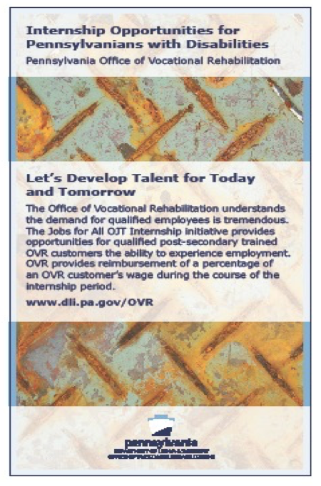
VR Outreach Materials
Notes:
Marketing materials used by field business service staff in outreach to potential sponsors on OJT talent and interest in support pre-apprenticeship and RA sponsors.

Slide 22
Challenges
Focus on success and having a good match of potential VR customer to a specific RA program and sponsor.
Start with one or two VR customers and build on successes.
Educate VR counselors on the benefits of RAs and the high wages in these careers.
Address best practices in monitoring customer progress throughout the experience that is similar to and not unlike college VR customer progress and milestones attainment.

Slide 23
How PA OVR & State RA Office Presented the Apprenticeship Career Training-ACT OJT Model to VR Counselors
The following slides are excerpts from the Statewide video conference training launch a purposeful plan to make RA an option for VR customers.
Since the launch we have enrolled VR customers in CVSHealth-facilitated retail sales, industry-based welding, and construction trades pre-apprenticeship certificate trainings at the OVR operated Commonwealth Technical Institute.
ACT-OJT is acronym for Apprenticeship Career Training,
On-the-Job Training. A wage and milestone
reimbursement to apprenticeship sponsors for VR
customers.

Slide 24

Apprenticeship and Training Office: A guide to Registered Apprenticeship

Slide 25
What is Registered Apprenticeship?
A structured occupational training program that combines on-the-job training (OJT) and related instruction in which workers learn the practical and conceptual skills required for a skilled occupation, craft, or trade.

Slide 26
Apprenticeship and Training Office: What do we want to accomplish?
Increase the number of Pennsylvania Registered Apprenticeship opportunities
Educate the uninformed (employers and job seekers) about the benefits of registered apprenticeship
Expand apprenticeship into non-traditional occupations

Slide 27
Steps to Establishing a Program
Identify an objective and engage the interested parties
Contact the ATO and/or US DoL Apprenticeship
Develop Work Processes for the On-the-Job Training (OJT)
Identify Sources for Related Instruction
Develop Selection Procedure/Requirements
Institute Affirmative Action Plan when necessary
Submit the Program to the reviewing Agency (State or Federal ATO)
Submit the Program to the Pennsylvania State Apprenticeship and Training Council
Register Program and Apprentice with PA Apprenticeship and Training Office

Slide 28
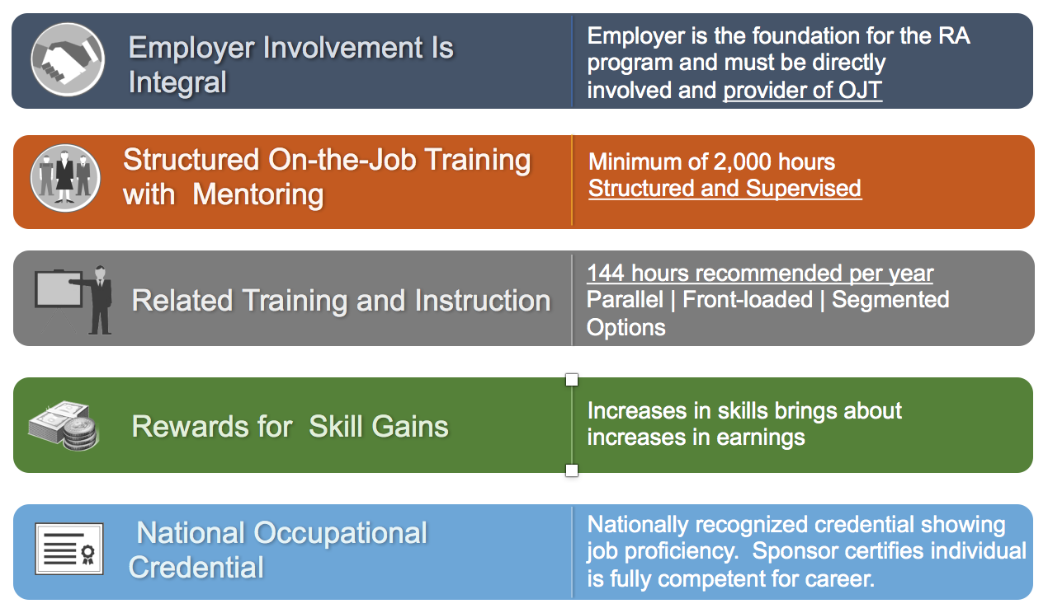

Core Components of Registered Apprenticeship

Slide 29
Each Registered Apprenticeship Program must have…
2,000 hours of on-the-job training (OJT)
Most programs last about 4 years, but can range from 1 to 6 years.
A minimum of 144 related instruction hours
Types of Related instruction:
Technical or Academic High Schools
Adult Night School
Community College
Universities
Correspondence Courses
Online Courses

Slide 30
What are the benefits of Registered Apprenticeship: Sponsors?
Benefits for the Sponsor…
Highly-skilled workforce
Reduced turnover rate
More productive employees
More diverse workforce

Slide 31
What are the benefits of Registered Apprenticeship: Workers?
Benefits for the Workers…
Increased skills
Higher wages – a built-in wage increase or step
National credential – It’s portable
Career advancement – Career pathways

Slide 32
What are employers looking for?
Soft Skills
Your best abilities are availability and reliability
Customer service – External and Internal
A willingness to learn
How well will you represent their company?

Slide 33
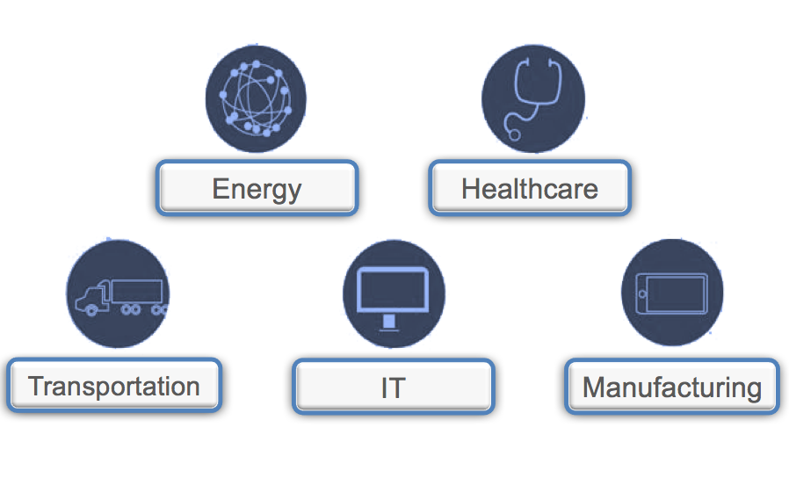
Registered Apprenticeship is
more than only construction

Slide 34
EXAMPLES OF OFFICIALLY RECOGNIZED APPRENTICE-ABLE OCCUPATIONS…..
BIO-MEDICAL EQUIPMENT TECHNICIAN
BUTCHER
CABLE SPLICER
DAIRY TECHNOLOGIST
TOOL AND DIE MAKER
ELECTRICIAN
CARPENTER
FLORAL DESIGNER
GLAZIER
LABORATORY ASSISTANT
MACHINIST
ENGRAVER

Slide 35
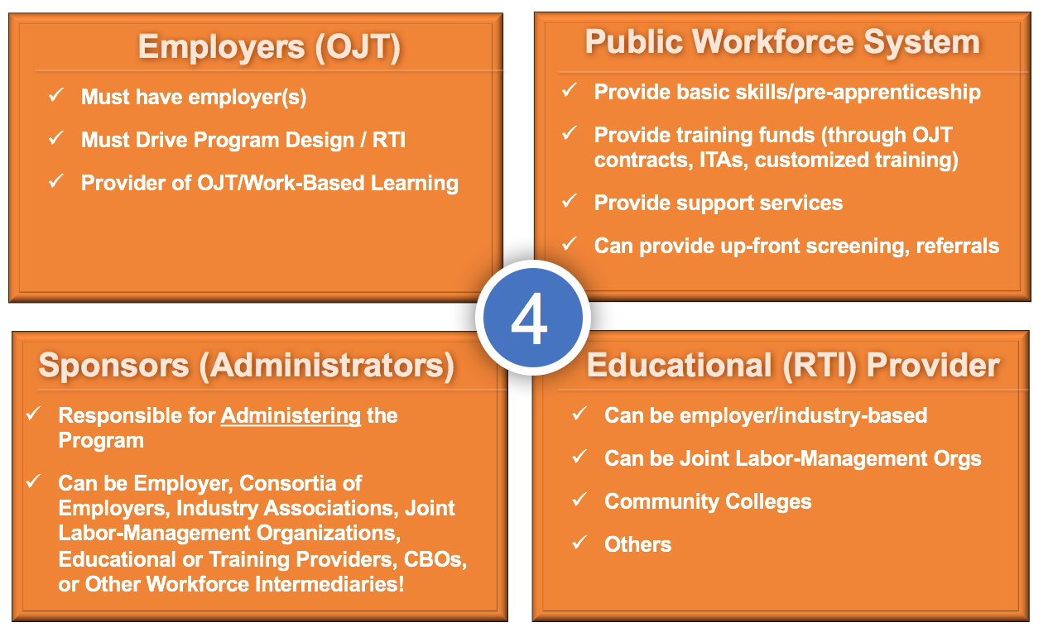
Key Roles within Registered Apprenticeships

Slide 36
Registered Apprenticeship can
or
work with multiple or single employers

Slide 37

Registered Apprenticeship: A proven job-driven approach
Checklist for Job-Driven Training
Work up-front with employers to determine local or regional hiring needs and designing training programs that are responsive to those needs.
Offer work-based learning opportunities with employers.
Measure and evaluate employment and earnings outcomes.
Promote a seamless progression from one educational stepping stone to another, and across work-based training and education.
Break down barriers to accessing job-driven training and hiring for any person who is willing to work, including access to supportive services and relevant guidance.
Create regional collaborations among local partners, education institutions, labor, and non-profits.

Slide 38
IN REVIEW….
Apprenticeship is a combination of OJT and related instruction
Apprenticeship is beneficial to the employer and the employee
Employers are looking for soft skills
There are over 1,000 apprentice-able occupations

Slide 39
Apprenticeship and Training Office: Contact Information
Contact Information
Eric Ramsay, Director
Apprenticeship and Training Office
651 Boas Street| 12th floor
Harrisburg PA 17121
Email: eramsay@pa.gov

Slide 40
OVR Apprenticeship OJT
After acceptance in a PA registered apprenticeship program reimbursement must adhere to the following
process:
Upon start of Apprenticeship a 30 day 100 % ACT-OJT applies with the case in status 18.
Upon progression in Apprenticeship from entrance to journeyman, (i.e., mid-point skill level) with a milestone lump sum payment $1000 to the employer. Case remains in status 18.
Upon last 30 days of Apprenticeship a 100 % ACT-OJT applies with the case moved into status 20.
Upon hire into fully integrated competitive closure after 90 days. Case placed in status 26.

Slide 41
Fee and Fund Codes
OJT Fee and Fund codes apply as described below:
Fee Schedule number and Fund Codes:
Fee Schedule Apprenticeship – 59507A
Fund Code for BBVS – A FFY 20__ or A.A FFY 20__
Fund Code for BVRS – 1 FFY 20__ or 1.1 FFY 20__
Lump sum mid-point Fee Schedule number and Fund Codes:
Fee Schedule Apprenticeship – 59507M
Fund Code for BBVS – A FFY 20__ or A.A FFY 20__
Fund Code for BVRS – 1 FFY 20__ or 1.1 FFY 20__

Slide 42
FNT Rule?
All provisions in the OJT Policy Memo apply when using ACT-OJT. The Financial Needs Test (FNT) will not be applied to the use of any OJT.

Slide 43
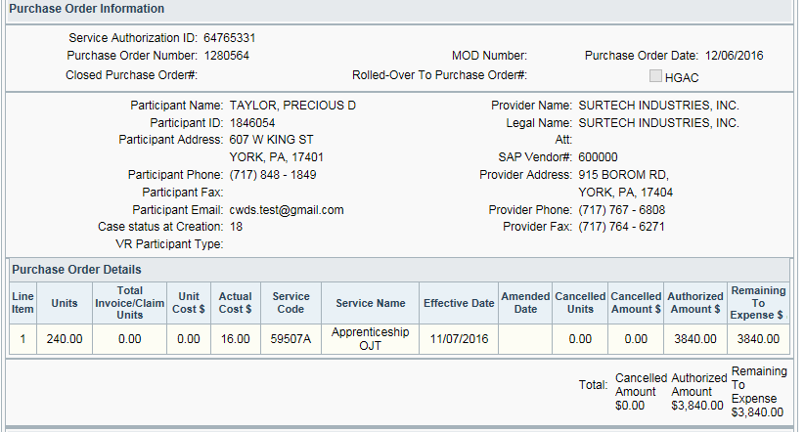
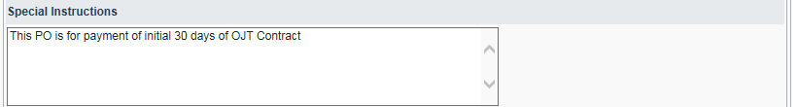
CWDS Snapshot: Initial 30 Days

Slide 44
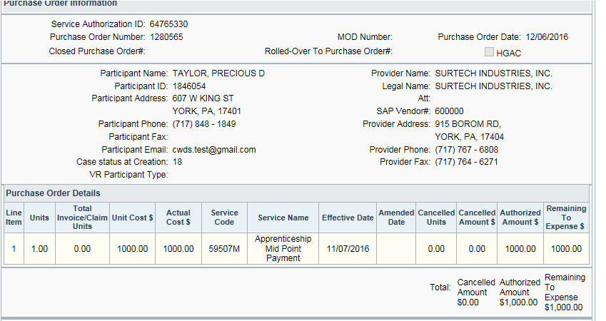
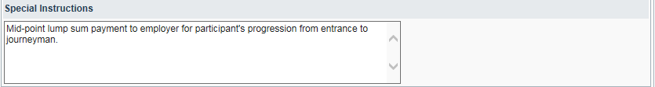
CWDS Snapshot: Mid-Point Lump Sum

Slide 45
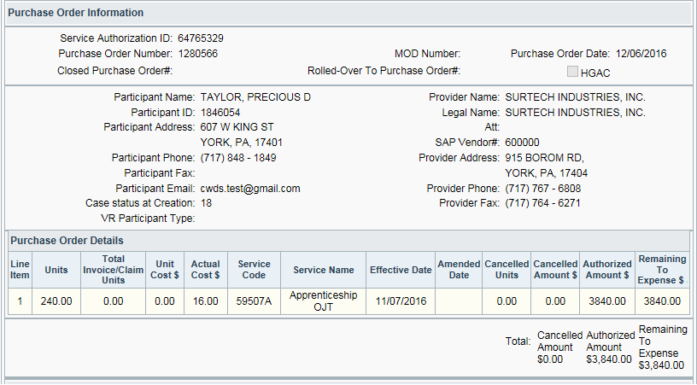
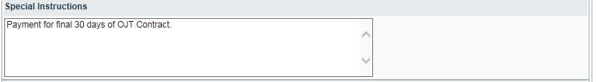
CWDS Snapshot: Final 30 Days

Slide 46
Pre-Apprenticeship Planning
Student must be in Status 02 or above
Need to educate parents & school staff
Vo-tech and pre-apprenticeship work experiences can help
HGAC is developing stackable skills and micro credentials

Slide 47
Apprenticeship Planning
Western PA Pilot with the Construction Guild
Eastern Pilot with SEPTA and CVS Health

Slide 48
Apprenticeship Planning-Next Steps
T-Drive File: Apprenticeship-OVR OJT Initiative File. Information including Frequently Asked Questions (FAQ) document will be added.
Western (Rob), Central (Jameson) and Eastern (Vondol) Specialists will be available for in-person meeting with District Offices upon request.
Non piloted Apprenticeships in other districts offices can use model and should connect the employer/sponsor with Eric Ramsey.

Slide 49
Let’s Talk!
Questions
Discussion
Next Steps
How Can We Help?
Notes:
Let’s talk!

Slide 50
Contact Information
Geri Scott, Director, Jobs for the Future: gscott@jff.org
Ralph Roach, Division Chief, Office of Vocational Rehabilitation, Pennsylvania Department of Labor and Industry: rroach@pa.gov
Eric Ramsay, Director, Apprenticeship and Training Office, Pennsylvania Department of Labor and Industry: eramsay@pa.gov
Tom Hooper, Assistant Director, Jobs for the Future: thooper@jff.org
Katie Allen, Knowledge Translation, Institute for Community Inclusion: katie.allen@umb.edu

